Slide 1

sig0namectl
sig zero name control

Slide 2
About
sig0namectl
sig0namectl is an empowering technology that allows on-line communities to securely browse, share and publish their own local services & resources.
It achieves this by utilising SIG(0) public keys stored within the Internet’s secure Domain Name System (DNSSEC) which allows verification of DNS responses and strong access control to all updates.
This allows participants to request an unused label within a DNS zone and securely publish information resources at or below the requested label.
WHY? To empower people to publish access details to local resources and digital services to their own neighbourhoods and communities.

Slide 3
Social Relevance
sig0namectl
Until now, only Internet Name Registrars, Data Centre Owners, or “cloud resellers” had the ability to update resource information directly into the DNS fabric – offering only limited insecure web portals for their customers to log in and make limited changes indirectly.
With so many service provider security hacks, such as domain hijacking and password leaks, many communities are looking for ways of securely managing their own Internet domain data, free from the risks of relying on third parties doing it on their behalf.
sig0namectl offers more secure, self-sovereign control over Internet domain resources which aligns with emerging EU cyber-security best practices.
Freifunk, the umbrella group for German community networks, is a development partner aligned in the aim to allow members to host services securely within their own existing decentralised community network infrastructure.

Slide 4
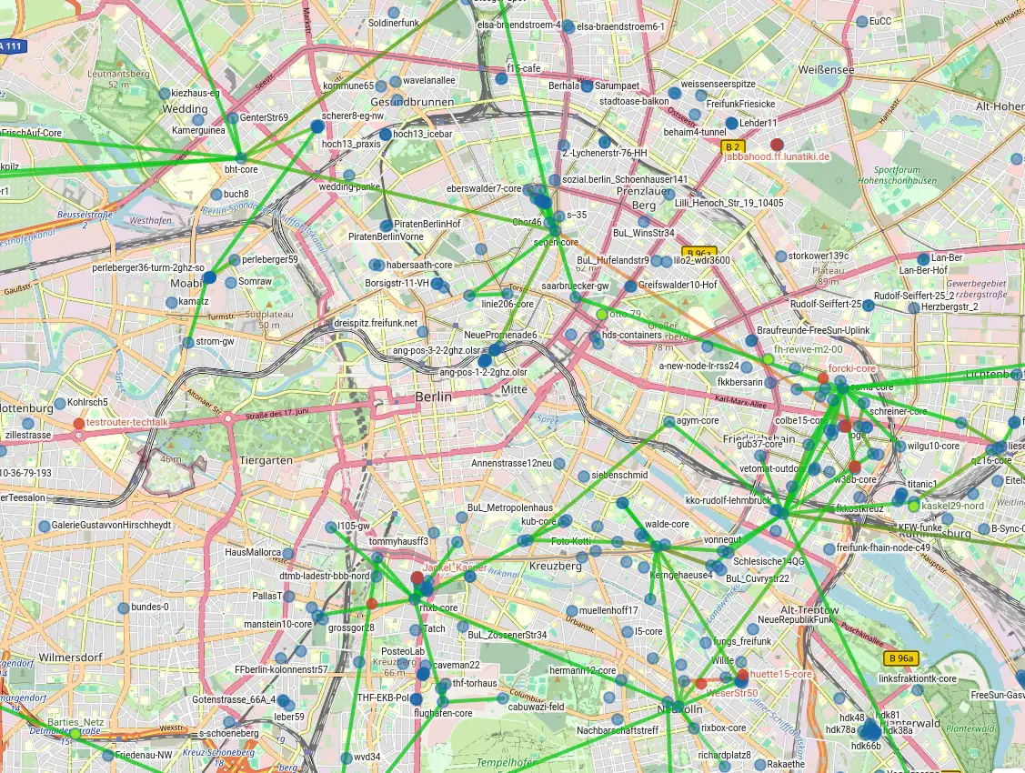
Test Group: Freifunk
sig0namectl
Freifunk is a German non-profit initiative providing free network access and open infrastructure with a mission to democratise communication.
In Berlin, Freifunk’s radio network is large, with over 500 nodes and WLAN hotspots spread throughout the city.
sig0namectl empowers Freifunk community users to collaborate, publish & make accessible local web resources:
on their own computers
in their own premises
over their own local networks.

Slide 5

Design Criteria
sig0namectl
Autonomy
Local first, unmediated access
Local services for local needs
Sustainability
Minimal resource footprint
Increased use of existing resources
Freedom
Community key trust anchor with DNSSEC
Alternatives to ISP & big tech services

Slide 6
System Requirements
sig0namectl
Low system requirements for resource constrained systems
Platform independent
Browser based GUI & command line development environments
Real-time DNS updates (minimal caching TTLs)
Decentralised local storage of all credentials
Modular API library for ease of maintenance

Slide 7

High Level Architecture
sig0namectl
Domain Name System
(updates via authoritative servers over UDP53 & DoH)
🤖
⌨
Workflow Automation
(detect & trigger)
Command Line Tools
Browser Applications
sig0namectl API Library

Slide 8
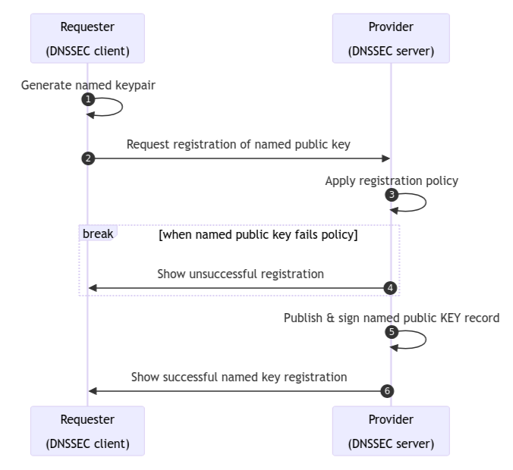
DNS Update KEY Requests
sig0namectl
First Come, First Served KEY allocation
Owners of KEY RRs at a zone apex apply a FCFS policy to process further KEY requests. KEY requests for a zone label are provisioned if & only if no label RRsets already exist.
Present mechanism: uses open update _signal zone & process_requests workflow tool.
Future mechanism: SRP (think ‘DHCP’ leases in EDNS0 header)
see https://datatracker.ietf.org/doc/draft-ietf-dnssd-srp/

Slide 9
BIND9 config example
sig0namectl
# Example BIND9 zone configurations for zenr.io
zone "zenr.io" IN {
type master;
file "dynamic/zenr.io/named.zenr.io";
key-directory "dynamic/zenr.io";
// auto-dnssec maintain;
dnssec-policy "default";
allow-transfer { 138.201.89.108; 2a01:4f8:c17:3dd5::1; };
update-policy {
grant "zenr.io" name zenr.io. ANY;
grant "zenr.io" subdomain zenr.io. ANY;
grant * selfsub . ANY;
};
};
zone "_signal.zenr.io" IN {
type master;
file "dynamic/_signal.zenr.io/named._signal.zenr.io";
key-directory "dynamic/_signal.zenr.io";
check-names warn;
// auto-dnssec maintain;
dnssec-policy "default";
allow-transfer { 138.201.89.108; 2a01:4f8:c17:3dd5::1; };
allow-update { any; };
};
zone apex key configuration
The initial zone apex KEY zenr.io is generated and granted permissions at and below its FQDN.
Subsequent added keys are given similar permissions at and below their label.

Slide 10


Workshop Tech Demo
sig0namectl
Checkout the GitHub Repo
🕸 https://github.com/NetworkCommons/sig0namectl
Try Examples & Tutorials for BASH, Golang & WASM JS
🕸 https://sig0namectl.networkcommons.org/tutorials/

Slide 11
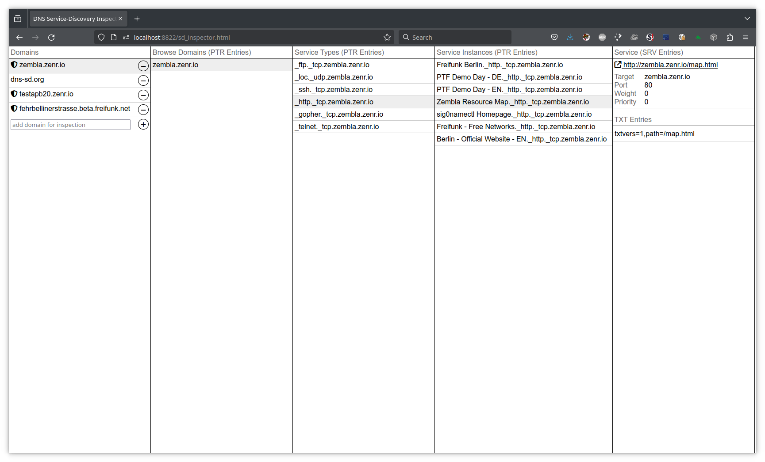
GUI: Service Discovery
sig0namectl
Service Discovery Inspector
Wide Area DNS-SD uses the same technology computers use to find printers & resources on a local network, but works across the entire Internet.
In expert mode, the SD Inspector web application lists and manages web sites & other network service types & resources published across different DNS domains.
Try live with QR code.

Slide 12
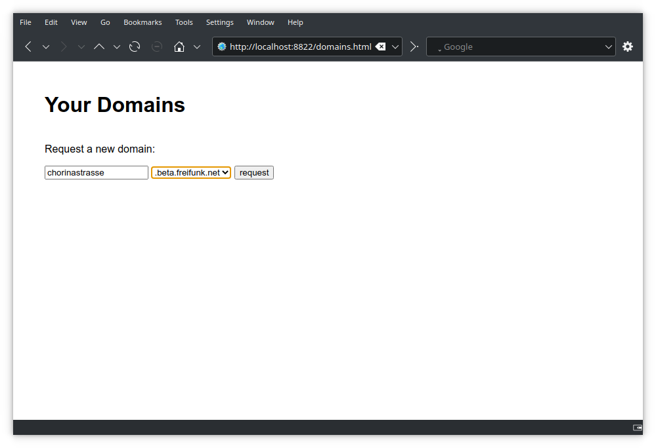

GUI: Domain Manager
sig0namectl
Domain Manager: Request New Domain
The domain manager application handles requests for new domain names.
The default “first come, first served” policy for sig0namectl means that if the full domain name does not exist already, the request will be granted.
Try it live with the QR code.

Slide 13
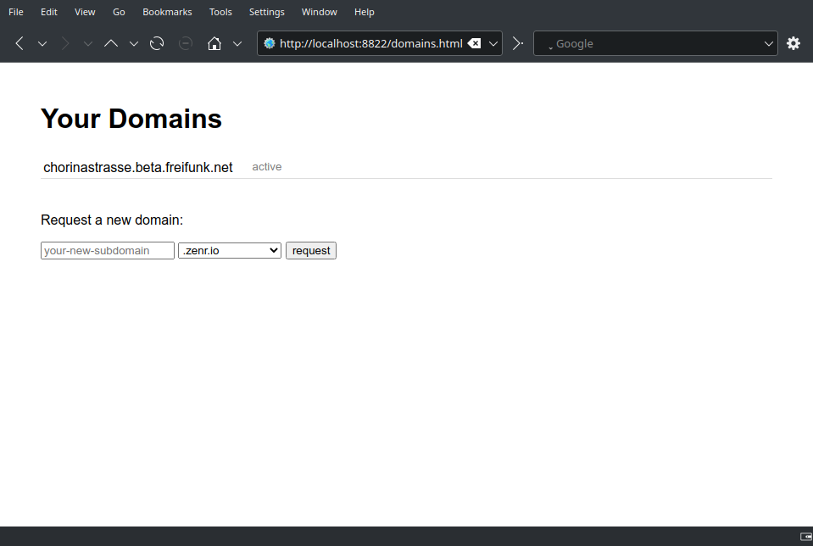
GUI: Domain Manager
sig0namectl
Domain Manager: Manage New Domain
Once successful domain requests are listed as active, DNS update rights for this domain have been granted & DNS resource records can be updated at or below this new domain by selecting it.
Note the domain management application is still under heavy development and is subject to change.

Slide 14
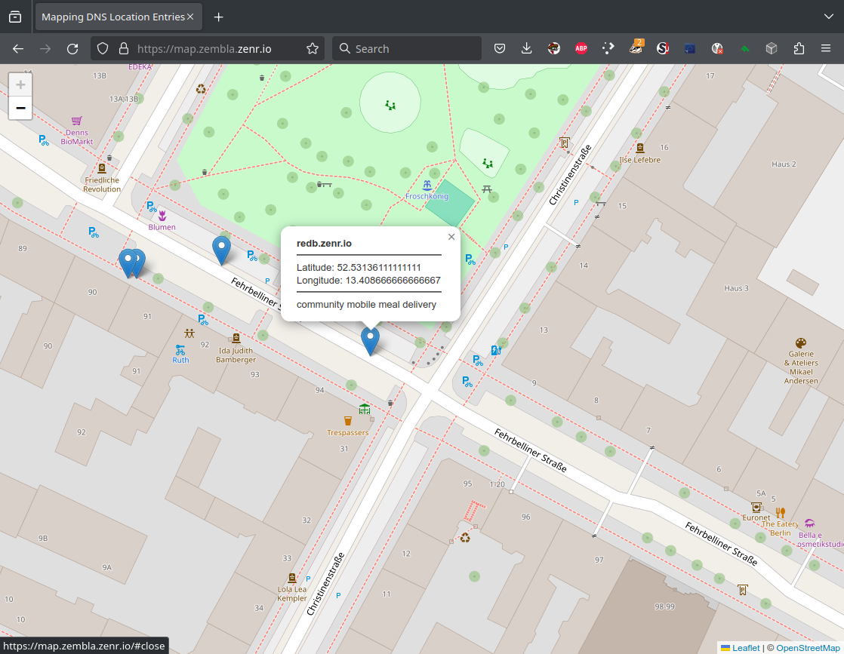

GUI: Resource Maps
sig0namectl
Resource group location map
A map application for local services & resources.
This example shows zembla.zenr.io’s resource map where each map point is added to zembla’s list. Each resource itself can dynamically update its own location & details in its own distinct DNS name space.
Try live with QR code.
Map of zembla.zenr.io’s resource locations
with detail of node redb.zenr.io offering local mobile meal delivery

Slide 15
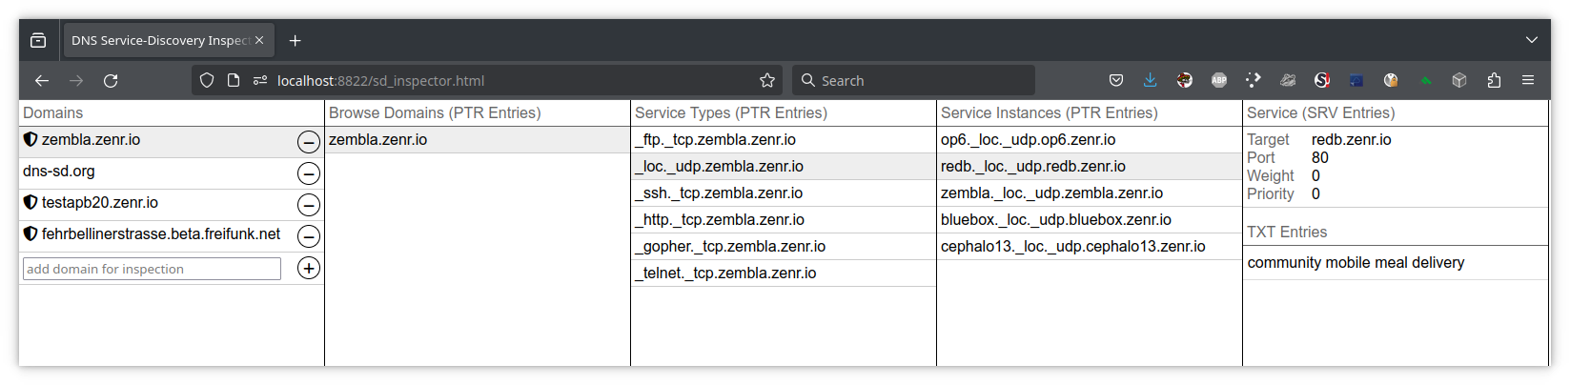
Automation at Work
sig0namectl
redb.zenr.io is an Android mobile phone.
It is regularly updating its own position into DNS with information from its GPS hardware by running the provided sig0namectl start_loc_loop.sh automation command line script.
See our documentation for further automation possibilities.
redb.zenr.io autonomously updates its own geolocation details into DNS

Slide 16
Status so far ...
sig0namectl
Technical innovations
Scalable, decentralised & secure dynamic DNS updates using SIG(0)
WebAssembly API for further Javascript in-browser application development
Standards-based dynamic DNSSEC and Wide Area DNS-SD compatibility
Fully open, easy to maintain core library developed in Golang
Infrastructure & deployment
Dynamic DNSSEC deployed across the Freifunk and Freifunk Berlin domain names
Service now online under zenr.io and beta.freifunk.net & beta.berlin.freifunk.net
Community Involvement
Freifunk Berlin monthly meetings with presentations & project updates
Freifunk Radio show appearances with interview & discussions
Project presentation at international Community Networking event (PicoPeering 2024)

Slide 17

Next Steps
sig0namectl
Browser app development
Further golang tool capabilities
OpenWRT router image integration
DANE, SSHFP, and new WALLET RR
Wireguard zeroconfig as DNSSD service

Slide 18

Contact
sig0namectl
🕸 https://sig0namectl.networkcommons.org
📧 sig0namectl@networkcommons.org

